Slide 1
Alexander Migdal
Duality of Fluid Mechanics and Solution of Decaying Turbulence
Talk at 127th Statistical Mechanics Conference,
December 2024

Slide 2
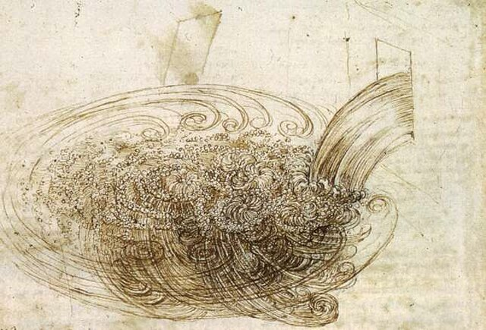
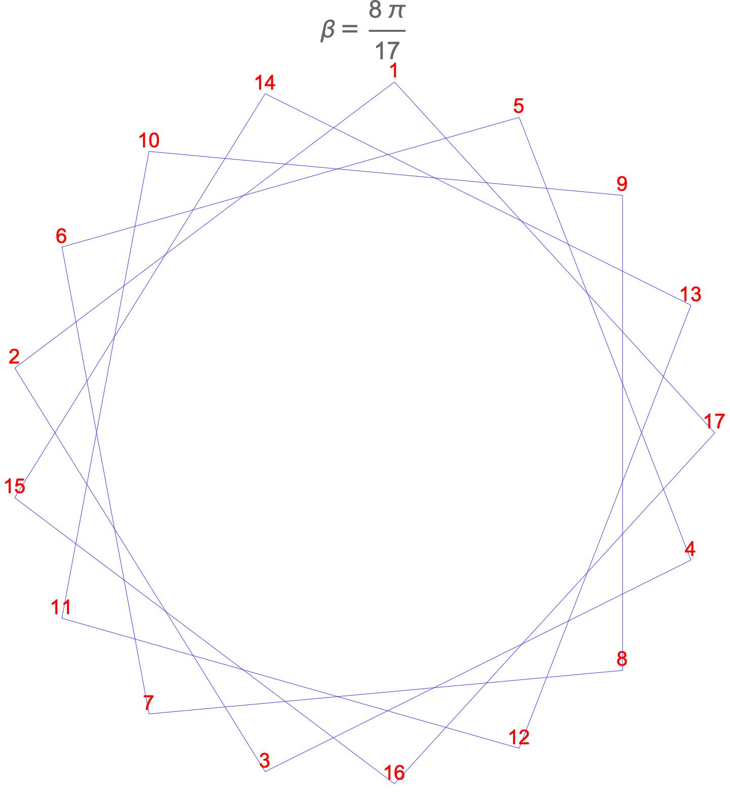
Duality of Turbulence to String Theory
Chaotic Vortex Motion
Random Walk on Star Polygons

Slide 3
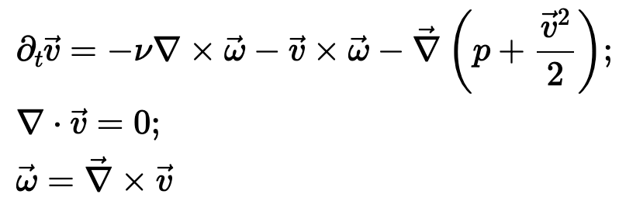
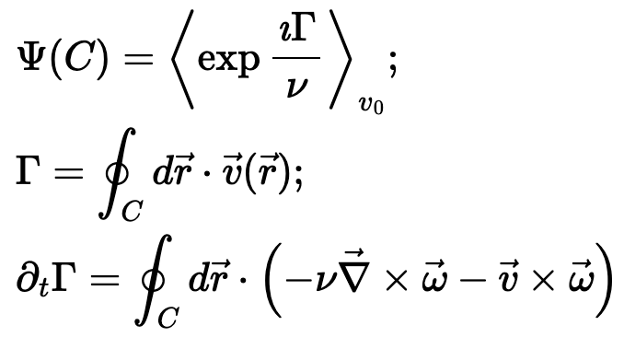
Evolution of the velocity circulation
(NS equation)
Loop functional
generates vorticity correlation functions by variations by C.
Pressure drops from the evolution equation.

Slide 4

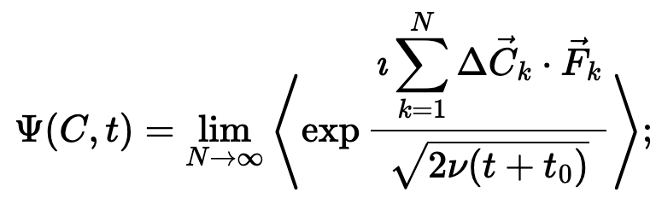
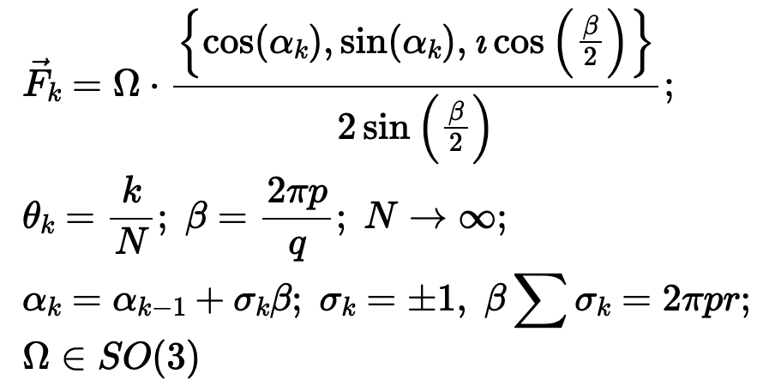
Solution of the NS equation for
(Time dependence of decaying turbulence)
(Euler ensemble = String theory with
Regular Star Polygons)
(Random Walk on
Regular Star Polygons)
(Constant Rotation Matrix)

Slide 5
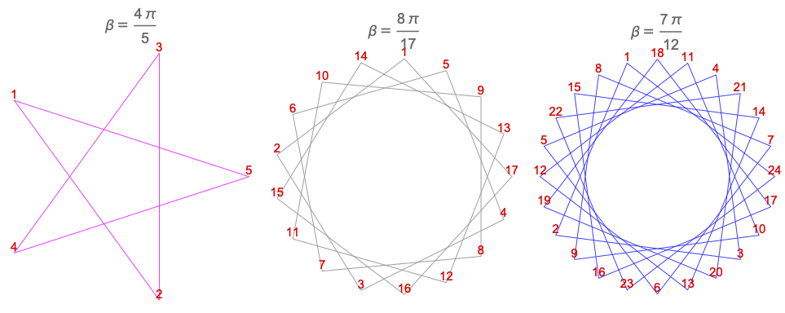
Regular Star Polygons

Slide 6

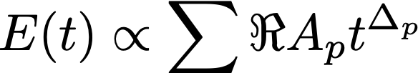
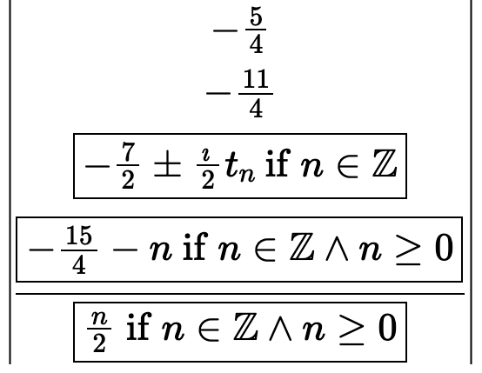
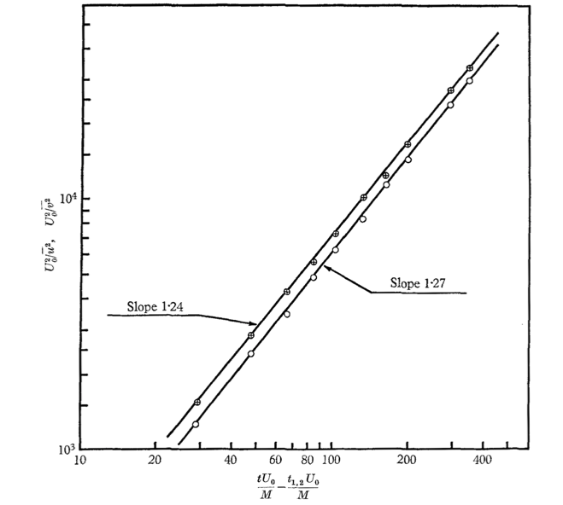
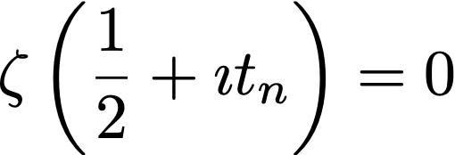
Decaying Energy Multi Scaling laws
Leading
Kolmogorov-Saffman model: 6/5 = 1.2
Comte-Bellot G, Corrsin S. data: 1.25

Slide 7
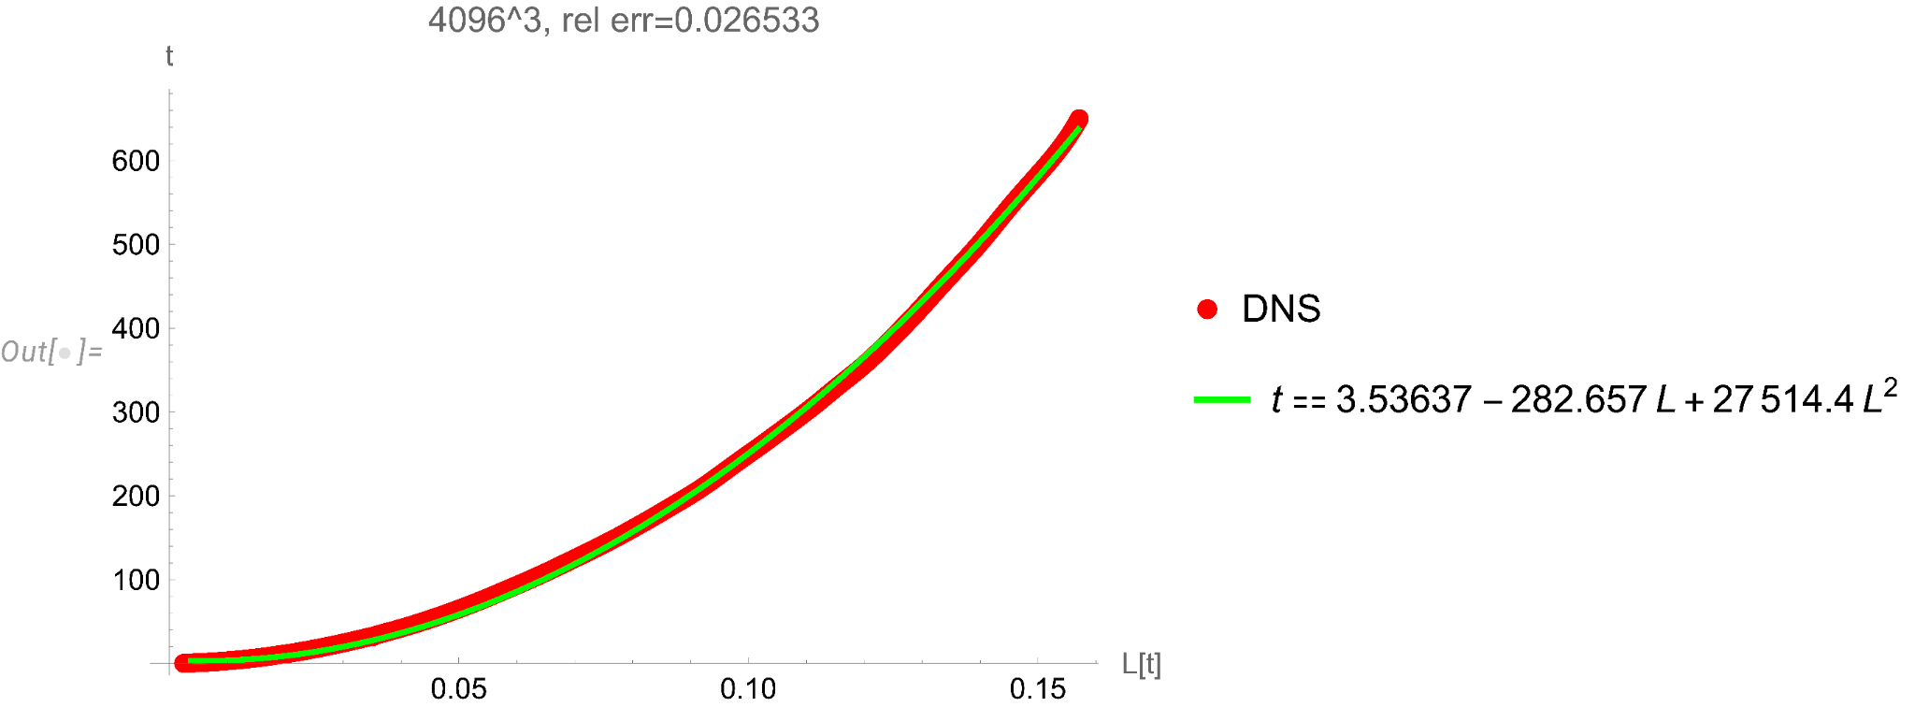
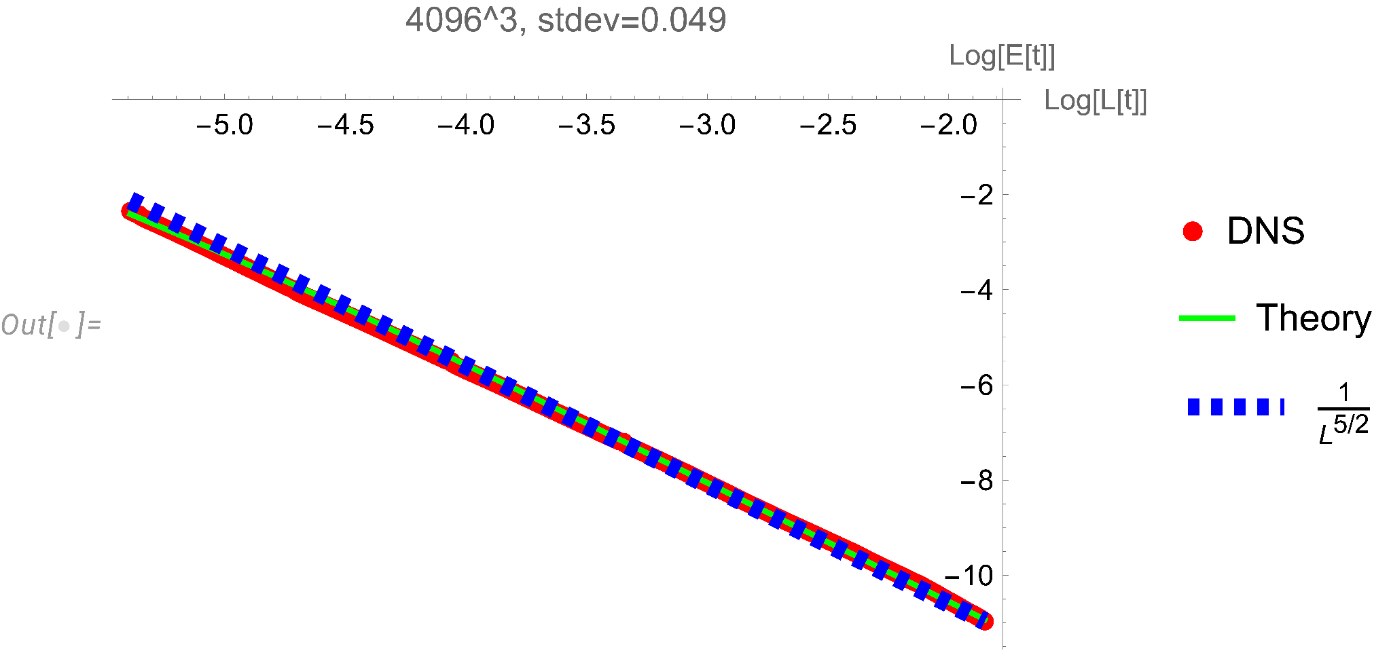
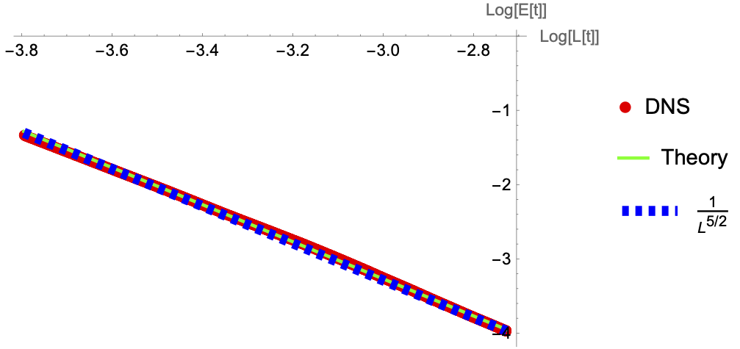
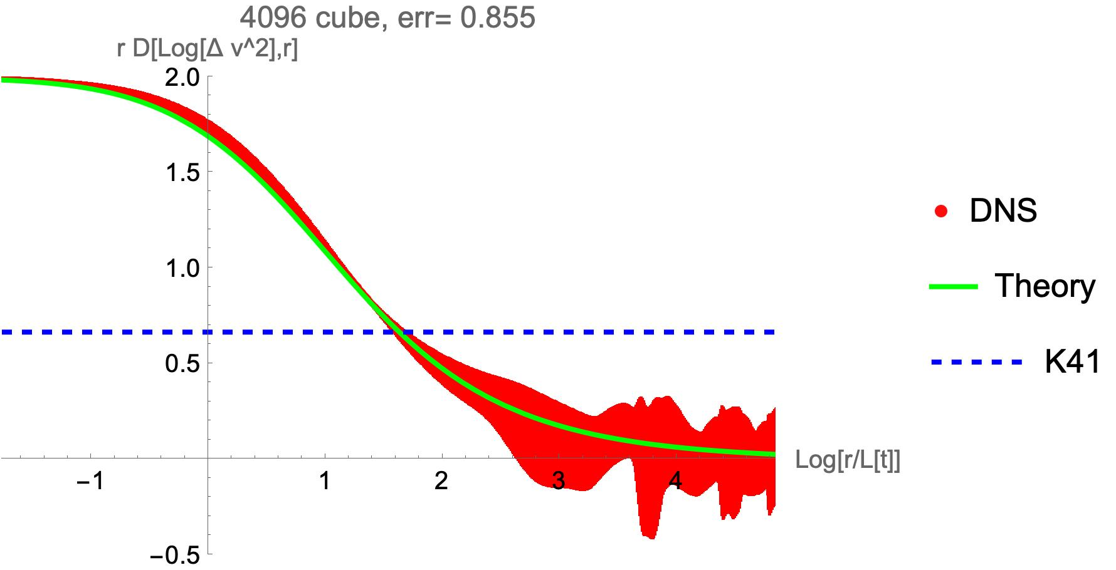
Verification by DNS (Sreenivasan et. al., 2024)

